Slide 1

URLTran: Improving Phishing URL Detection Using
Transformers
Presented By
Madan Baduwal
Prakash Madai

Slide 2
Contents
Problem Statement
Introduction and Related work
Transformer Components
Benchmark Papers
Technical Tools
Dataset
Pseudocode
Results
Conclusion
Demo

Slide 3
Problem Statement
In the past, some browsers evaluated an unknown URL for inclusion in a list of known phishing pages
The number of URLs and known phishing pages continued to increase at a rapid pace, browsers started to include one or more machine learning classifiers for better security end users from harm
Phishing attacks are a significant cyber threat that traditional rule-based methods and machine learning-based approaches have difficulty detecting due to their dynamic nature.
This project aims to develop a deep learning-based model using the transformer architecture to detect phishing attacks with high accuracy by training on a large dataset of phishing and legitimate websites, and is expected to outperform traditional approaches in detecting sophisticated phishing attacks.

Slide 4
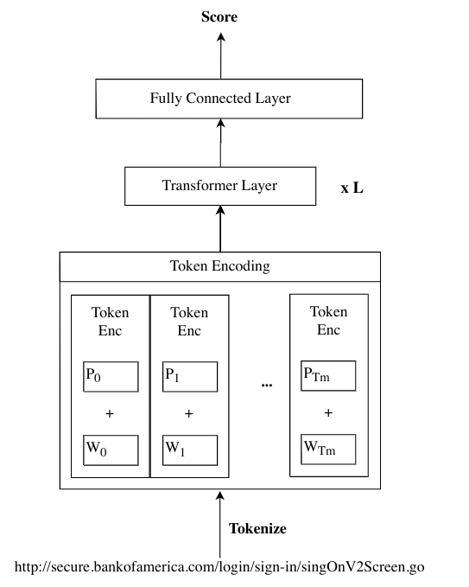
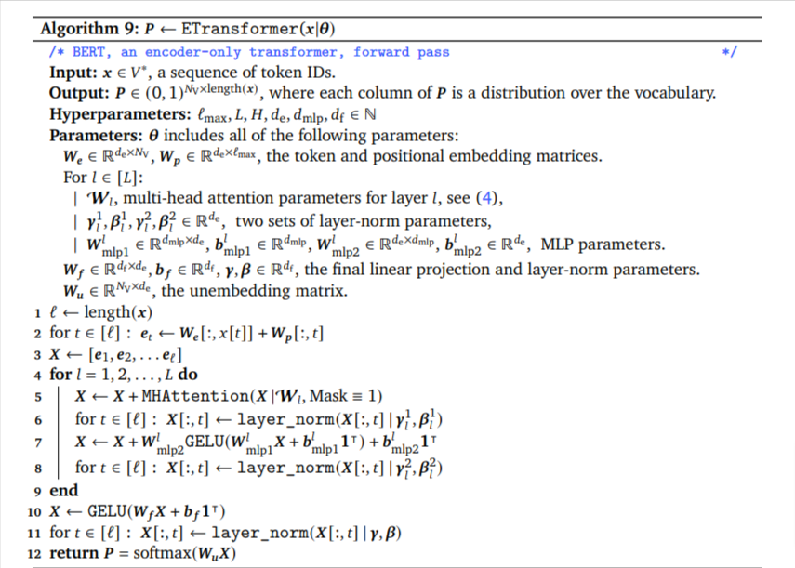
Introduction and Related work
Reference

Slide 5
Transformer Components
A transformer is a type of neural network architecture that was introduced in the paper "Attention Is All You Need" by Vaswani et al. (2017). Transformers are particularly well-suited for natural language processing (NLP) tasks such as language translation, sentiment analysis, and language modeling.
Input Embeddings: Text to token and token to high dimensional vector
Positional Encodings: Describes the location or position of an entity in a sequence so that each position is assigned a unique representation
Transformer Encoder Layer
Multi-Head Self-Attention: capture contextual relationships between different parts of a sequence at once in parallel
Layer Normalization: Stabilize the training process and improve the performance of the model by reducing to small number to reduce computation
Feedforward Neural Network: Type of artificial neural network where the information flows only in one direction, from the input layer to the output layer. Maps output to probabilities

Slide 6
Benchmark Papers
Title: URLTran Improve Phishing URL Detection Using Transformer
Datasets: 200,100
Accuracy: 92.38%
Title: A Transformer-based Model to Detect Phishing URLs
Datasets: 250,100
Accuracy: 91.01%

Slide 7
Technical Tools
Python3.10
Pytorch: ML library for Python that provides a flexible and efficient way to build and train deep neural networks
NLTK : Python library used for NLP tasks such as tokenization, stemming, tagging, parsing, and semantic reasoning.
Pickle: Python module that provides a way to serialize and deserialize Python objects into a format that can be stored or transmitted
Sklearn : Python library to implement machine learning models and statistical modelling
Numpy: Mathematical Operations
Streamlit : Open-source framework for rapid prototyping and the creation of visualizations and dashboards in Python

Slide 8
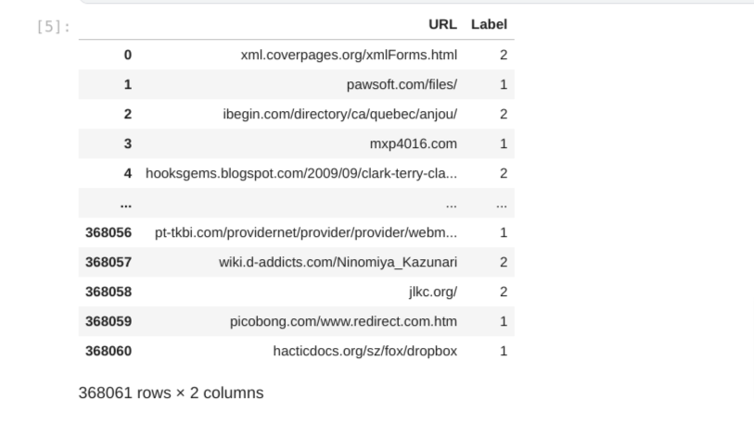
Dataset

Slide 9
PseudoCode
Hyperparameter tuning
Added Multiple attention layers
Used RELU instead of GELU

Slide 10
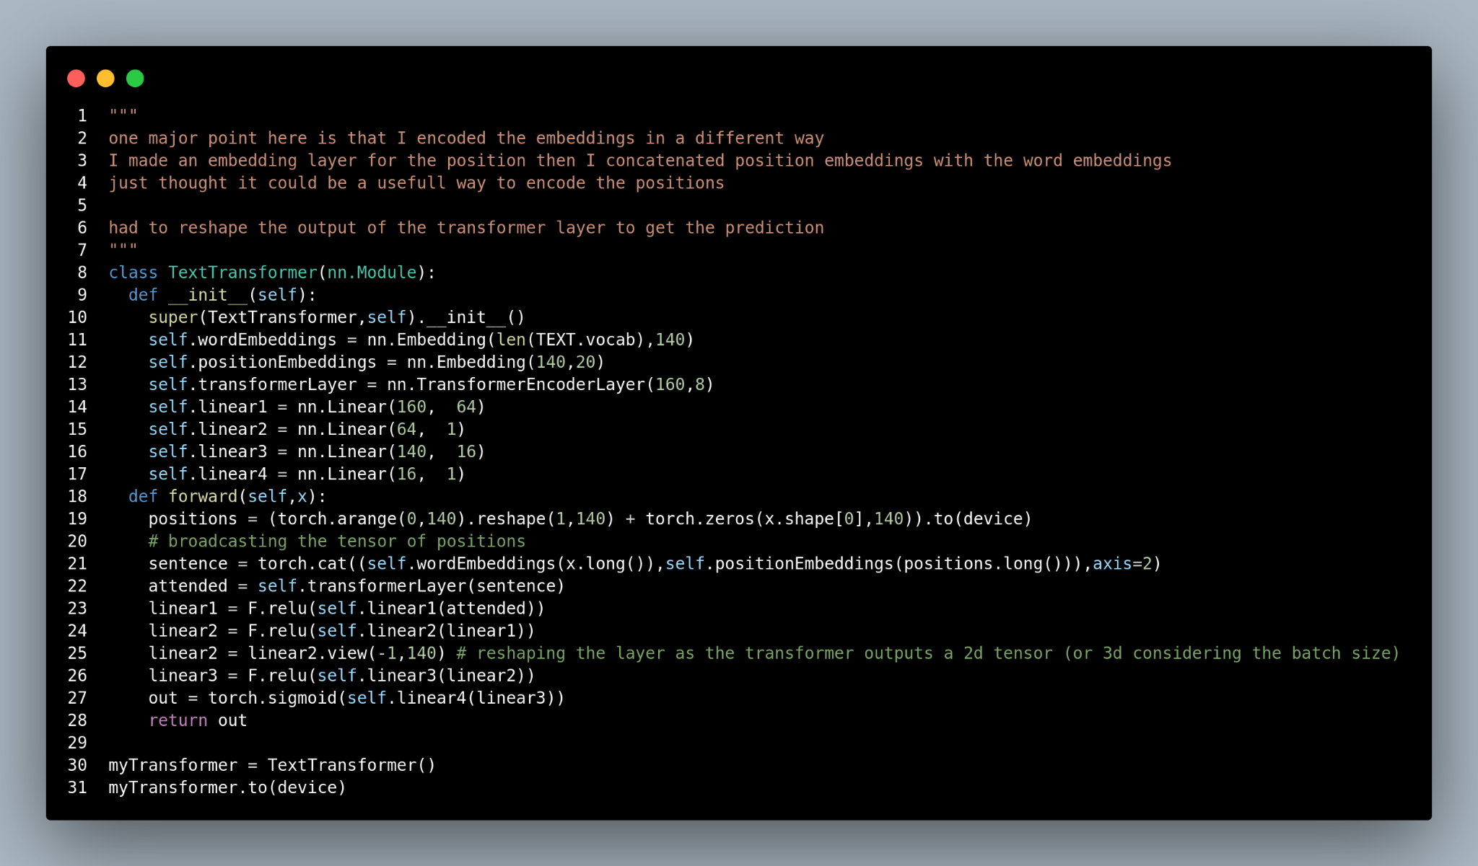
Methodology | ImpURLTran

Slide 11
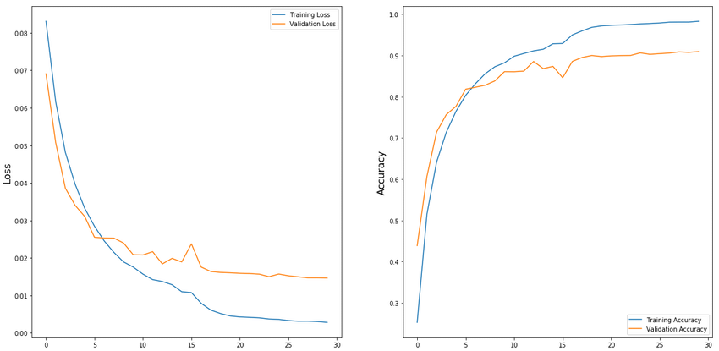
Results

Slide 12
Conclusion
URLTran is a new transformer-based system that predicts whether an unknown URL is a phishing or a benign web page.
Transformers, which have shown success in natural language processing, are applied to the cybersecurity domain.
URLTran uses BPE tokenizers instead of lexical features or CNN kernels.
Transformers convert the token sequence to an embedding vector, which is input to a dense linear layer.
URLTran outperforms recent baselines, especially at very low false positive rates.
The system can be made robust to novel attacks by adversarially augmenting training data.

Slide 13
Demo
Non Phishing:
https://www.bankofamerica.com/
https://google.com/
https://www.facebook.com/
https://500px.com/photo/17733655/rain-in-the-city-by-dragox-photo-?from=set&set_id=1074128
Phishing:
http://secure.bankofamerica.com/login/sign-in/singOnV2Screen.go
http://tinnhanh360.net/clip-ve-cuoc-song-cua-nhung--con-nghien-smartphone-gay-sot.html
http://kenh14.vn/2-tek/dam-minh-trong-the-gioi-am-nhac-cung-sony-headphone-20130517085043821.chn
http://9gag.tv/p/aKjXXg/blind-man-dropped-wallet-if-people-would-steal-it-stunning-social-experiment
http://maybank2u.com.my/mbb_info/m2u/public/personalList04.do?channelId=BBSME-Trade&programId=BBSME-Trade_Export1&chCatId=/mbb/BBSME/BBSME-Trade
Deployed Version

